Slide 1
UNDERGRADUATE THESIS PROPOSAL
CSE 4100: Project or Thesis with Seminar Part I
Signal-Aware ML Calibration for Low-Cost Pan-Tilt LiDAR
Varendra University
Department of Computer Science and Engineering
7th Semester | Section E
Presenters
SUPERVISOR
Abdul Momit Talukder — 232311320
Oishi Farzana — 232311294
Mahfuz Ahmad — 232311307
Mohd Ruhul Ameen
Lecturer
Department of CSE
Varendra University

Slide 2
How Do Machines “See” 3D?
Distance + Direction → 3D Geometry
Measure
Rotate
Reconstruct
Room
Rays
Points
Point cloud
Signal-Aware ML Calibration for Low-Cost Pan-Tilt LiDAR · Thesis Proposal
2 / 16
Notes:
Abdul. Keep this intuitive: a sensor measures distance, we know which direction it was pointing, and together that gives one 3D point. Rotate the sensor and repeat, and the points build up into the geometry of the room.

Slide 3
3D Sensing Is Powerful — But Expensive
$500+
~$25
Commercial LiDAR
Our target
High performance is expensive.
Low cost often means lower accuracy.
Signal-Aware ML Calibration for Low-Cost Pan-Tilt LiDAR · Thesis Proposal
3 / 16
Notes:
Abdul. Commercial LiDAR starts around $500+; our target for the whole scanner is roughly $25. The tension: low cost usually costs accuracy. This thesis is about closing that gap with the sensor's own signal information.

Slide 4



Why Time-of-Flight?
SELECTED
Ultrasonic
Radar
ToF
Wide beam
Lower spatial resolution
Strong indoor complexity
Compact
Fast
Fine spatial sensing
Signal-Aware ML Calibration for Low-Cost Pan-Tilt LiDAR · Thesis Proposal
4 / 16
Notes:
Abdul. Keep it light. Ultrasonic has a wide beam and lower spatial resolution; radar brings strong indoor complexity. Time-of-flight is compact, fast, and gives fine spatial sensing, so that is what we chose.

Slide 5
Our Hardware Architecture
Proposed final platform
ACTUATION
SUPPORTING SENSORS
VL53L1X ToF Sensor
MPU6050 IMU
DC Gear Motor — Pan
DHT11 Temperature
Pan–Tilt Mechanism
N20 Motor — Tilt
INA219 Power monitor
ESP32
TB6612FNG — Motor driver
Signal-Aware ML Calibration for Low-Cost Pan-Tilt LiDAR · Thesis Proposal
5 / 16
Notes:
Abdul (team leader, hardware lead). Walk the diagram: VL53L1X ToF sensor on a pan-tilt mechanism, driven by a DC gear motor (pan) and an N20 motor (tilt) through a TB6612FNG driver, all coordinated by the ESP32. MPU6050, DHT11 (temperature, an auxiliary feature) and INA219 support the system. Explain why this architecture was chosen and that this is the PROPOSED final platform, not the pilot prototype.

Slide 6
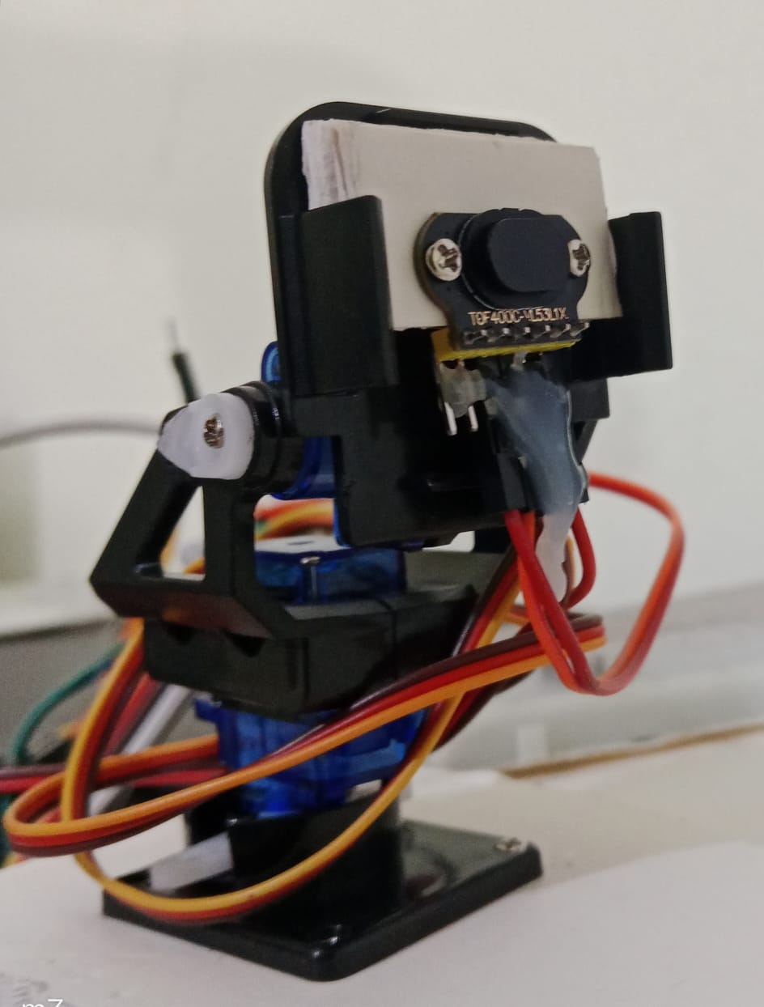
From Concept to Pilot
68,000+
pilot measurements
2 indoor campaigns
Pilot prototype ≠ Final thesis platform
Preliminary SG90-based prototype used for pilot data collection
Signal-Aware ML Calibration for Low-Cost Pan-Tilt LiDAR · Thesis Proposal
6 / 16
Notes:
Abdul. This is what we actually built and tested: an SG90-based pan-tilt prototype that produced 68,000+ measurements across two indoor campaigns. Explain how it was assembled and what we learned, and why it motivates optimizing the hardware for the final thesis. Important: this prototype is NOT the final proposed platform. (Replace the placeholder with the photograph from the proposal.)

Slide 7
Scan → Measure → Repeat → Reconstruct
Pan
Tilt
Measure
Point
Repeat
A few points
Hundreds of points
Thousands of points
Each distance measurement becomes one 3D point.
Signal-Aware ML Calibration for Low-Cost Pan-Tilt LiDAR · Thesis Proposal
7 / 16
Notes:
Oishi. No equations. The scanner turns, takes a distance reading, and records one point; repeat that thousands of times and the points form a 3D picture of the room.

Slide 8

The Real World Is Messy
ToF
Weak Return
Mixed Returns
Ambient Noise
→ Range Error
Signal-Aware ML Calibration for Low-Cost Pan-Tilt LiDAR · Thesis Proposal
8 / 16
Notes:
Oishi. Real rooms are messy. A dark surface sends back a weak return; reflective or mixed surfaces send back mixed returns; bright room lighting adds ambient noise. All of these show up as range error. Keep it non-technical.

Slide 9





Scale the Evidence
Indoor
PROPOSED TARGET
150,000+
Outdoor
Different Lighting
measurements
Different Surfaces
Paired with ground-truth measurements
Signal-Aware ML Calibration for Low-Cost Pan-Tilt LiDAR · Thesis Proposal
9 / 16
Notes:
Oishi. The pilot gave 68,000+ measurements; the final thesis proposes 150,000+ (a target, not yet achieved) across indoor and outdoor environments, different lighting and different surfaces, each paired with ground truth. More varied data is what lets a model handle new rooms.

Slide 10



Will It Work in a New Environment?
DARK ROOM
NEW / BRIGHT ROOM
NEW ENVIRONMENT
?
Model works
Error increases
Can it generalize?
Open challenge for the final thesis — not yet solved.
Signal-Aware ML Calibration for Low-Cost Pan-Tilt LiDAR · Thesis Proposal
10 / 16
Notes:
Oishi. A model can look good in the room it learned from, then lose accuracy somewhere new or brighter. Whether it carries over to a completely new environment is the open question this thesis is designed to test. We have NOT solved it yet.

Slide 11



Democratizing 3D Sensing
Education
Robotics
Assistive Technology
Affordable research
Low-cost spatial awareness
Obstacle/environment sensing
Advanced sensing should not require expensive hardware.
Signal-Aware ML Calibration for Low-Cost Pan-Tilt LiDAR · Thesis Proposal
11 / 16
Notes:
Oishi. Who benefits: education and affordable research, robotics needing low-cost spatial awareness, and assistive technology for obstacle and environment sensing. Keep it inspirational but grounded: we are not claiming a finished product.

Slide 12
Don’t Use Distance Alone
Raw Distance
Pan Angle
Tilt Angle
Signal-Aware ML
Predicted Error
Corrected Distance
Signal Rate
photon-related telemetry
Ambient Rate
photon-related telemetry
Signal rate + ambient rate: the sensor’s own internal signal information
Temperature
auxiliary · DHT11
Signal-Aware ML Calibration for Low-Cost Pan-Tilt LiDAR · Thesis Proposal
12 / 16
Notes:
Mahfuz. The idea: do not trust raw distance alone. Feed the model raw distance, pan and tilt angle, plus VL53L1X signal rate and ambient rate (internal photon-related telemetry) and DHT11 temperature (an auxiliary environmental feature, not photon telemetry). The model predicts the range error (residual formulation), which is then used to produce a corrected distance. Signal rate and ambient rate are the core signal-aware contribution.

Slide 13





From Python to ESP32
Train
Transpile
Deploy
Python / ML
Model → C
ESP32
< 100 μs
inference target
Zero external runtime dependency
Signal-Aware ML Calibration for Low-Cost Pan-Tilt LiDAR · Thesis Proposal
13 / 16
Notes:
Mahfuz. Train in Python, transpile the trained model to C, and deploy on the ESP32 so inference runs on the device with no cloud or external runtime. < 100 μs is an inference TARGET. In the pilot we completed preliminary ESP32 model transpilation; final model selection and deployment are proposed thesis work.

Slide 14
Pilot Results: Promising, but Not Final
94.7%
22.4 mm
MAE reduction
MAE
Day 2 pilot
pooled pilot training
PILOT · PRELIMINARY
Not a final accuracy guarantee
XGBoost: 49.34 mm MAE (Day 2 pilot)
Pilot results; final evaluation will use corrected ground truth and scan-level validation.
Signal-Aware ML Calibration for Low-Cost Pan-Tilt LiDAR · Thesis Proposal
14 / 16
Notes:
Mahfuz. Pilot only. In the Day 2 pilot, XGBoost reached 49.34 mm MAE, a 94.7% MAE reduction; pooled pilot training reached 22.41 mm MAE under the current pilot protocol. The bar chart shows relative error derived from the 94.7% reduction (raw = 100%, calibrated = 5.3%). These are NOT final thesis performance: the final evaluation will use corrected, object-aware ground truth and scan-level / leave-one-scan-out validation.

Slide 15



From Pilot → Robust System
1
2
3
4
Optimize Hardware
150K+ Measurements
Third Unseen Environment
Prove Generalization
Compare pan-tilt actuator options
Indoor + outdoor, improved ground truth
Held-out test of generalization
Scan-level, leave-one-scan-out validation
Final 3D reconstruction + ESP32 deployment
Signal-Aware ML Calibration for Low-Cost Pan-Tilt LiDAR · Thesis Proposal
15 / 16
Notes:
Mahfuz. Four stages, simplified from the proposal timeline: optimize the hardware, collect 150K+ measurements, test on a third unseen environment, then rigorously validate generalization with scan-level / leave-one-scan-out validation. The end goal is a final 3D reconstruction with the selected calibration model deployed on the ESP32.

Slide 16



Built to Be Shared
CODE
HARDWARE
DATA
GitHub
Open design
Public dataset
Low-cost sensing. Reproducible research. Open access.
https://github.com/Mr-Mahfuz/signal-aware-tof-calibration
Thank You
Questions?
Signal-Aware ML Calibration for Low-Cost Pan-Tilt LiDAR · Thesis Proposal
16 / 16
Notes:
Mahfuz. Close on openness: code on GitHub, open hardware design, and a public dataset. Then thank the committee and invite questions. Central idea to repeat: we are turning a very cheap ToF sensor into a more capable 3D sensing system by using the sensor's own signal information to learn and correct its errors directly on the edge.

